Slide 1

Credit Card Marketing Acceptance
Ryan Natanael Sihono JCDS
2020

Slide 2

PROJECT DESCTIPTION
Credit Card becomes part of our life thanks to human invention.
Credit Card is issued by bank; and one of the most essential profit for bank.
People are having tendency to have more than one card; becomes opportunity for bank people to offer more.

Slide 3

PROJECT GOALS
The goal of this project is to create a web application based on local host to classify whether the customers with their current condition are willing to create a new credit card
Data Gathering
Data Cleaning, Analyzation and Visualization
Data Splitting
Fitting Data with Models
Model Testing
Best Model Findings
Deploy Best Model for Apps
Create Apps
Store

Slide 4

DATA INSIGHT
Source : data.world
Total Data : 18000 rows
Columns : 17 features
(Customer Number, Offer Accepted, Reward, Mailer type, Income Level, Bank Account open, Overdraft Protection, Credit Rating, Credit Card Held, Homes Owned, Household Size, Own Your Home, Average Balance, Q1 Balance, Q2 Balance, Q3 balance, Q4 Balance)
Target Column : Offer Accepted

Slide 5
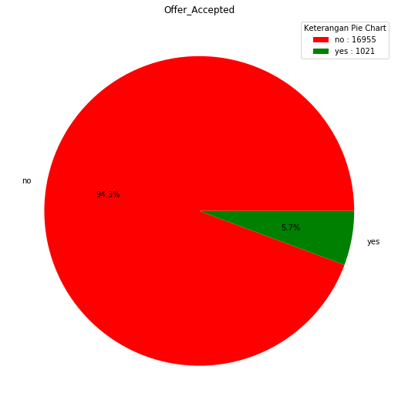
DATA INSIGHT
The data is heavily imbalance. Most of people are not creating new Credit Card.

Slide 6
DATA INSIGHT
Customer Number : customer id based on DB
Offer Accepted : customer decision (main data target)
Reward : current customer reward
Mailer type : customer desired target of ads type
Income Level : customer indication of income (apx)
Bank Account open : number of Bank Account owned
Overdraft Protection : over limit protection on previous/current cc
Credit Rating : rating of financial ability
Credit Card Held : number of credit card currently held
Homes Owned : number of purchased home(s)
Household Size : current house size (apx)
Own Your Home : indication of living in their own house
Average Balance : account average balance for 12 months
Q1 Balance : first quarterly balance
Q2 Balance : second quarterly balance
Q3 balance : third quarterly balance
Q4 Balance : fourth quarterly balance
*note: “apx” means ‘approximation’

Slide 7
DATA INSIGHT
ASSUMPTIONS
DATA DROPED
Customer Number
DATA DUMMIED
Reward, Mailer Type, Hold Home
Income Level, Overdraft Protection, Credit Card Held

Slide 8

MACHINE LEARNING MODEL

Slide 9
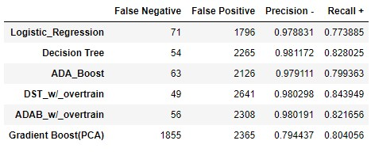
MODELS
The Models are (with some models fit with oversampling data):
Logistic Regression
Decision Tree Classifier
ADA Boost Classifier
Gradient Boost Classifier

Slide 10
MODELS
The Most Important Point: Low False Negative Number
Assumption: More people that willing to create new Credit Card can be detected

Slide 11
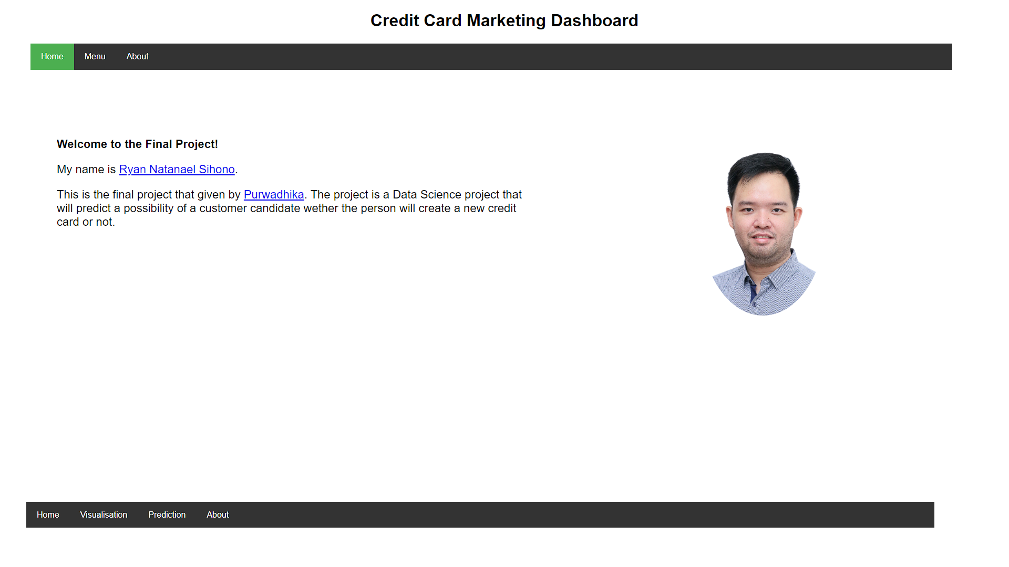
Application : Home

Slide 12
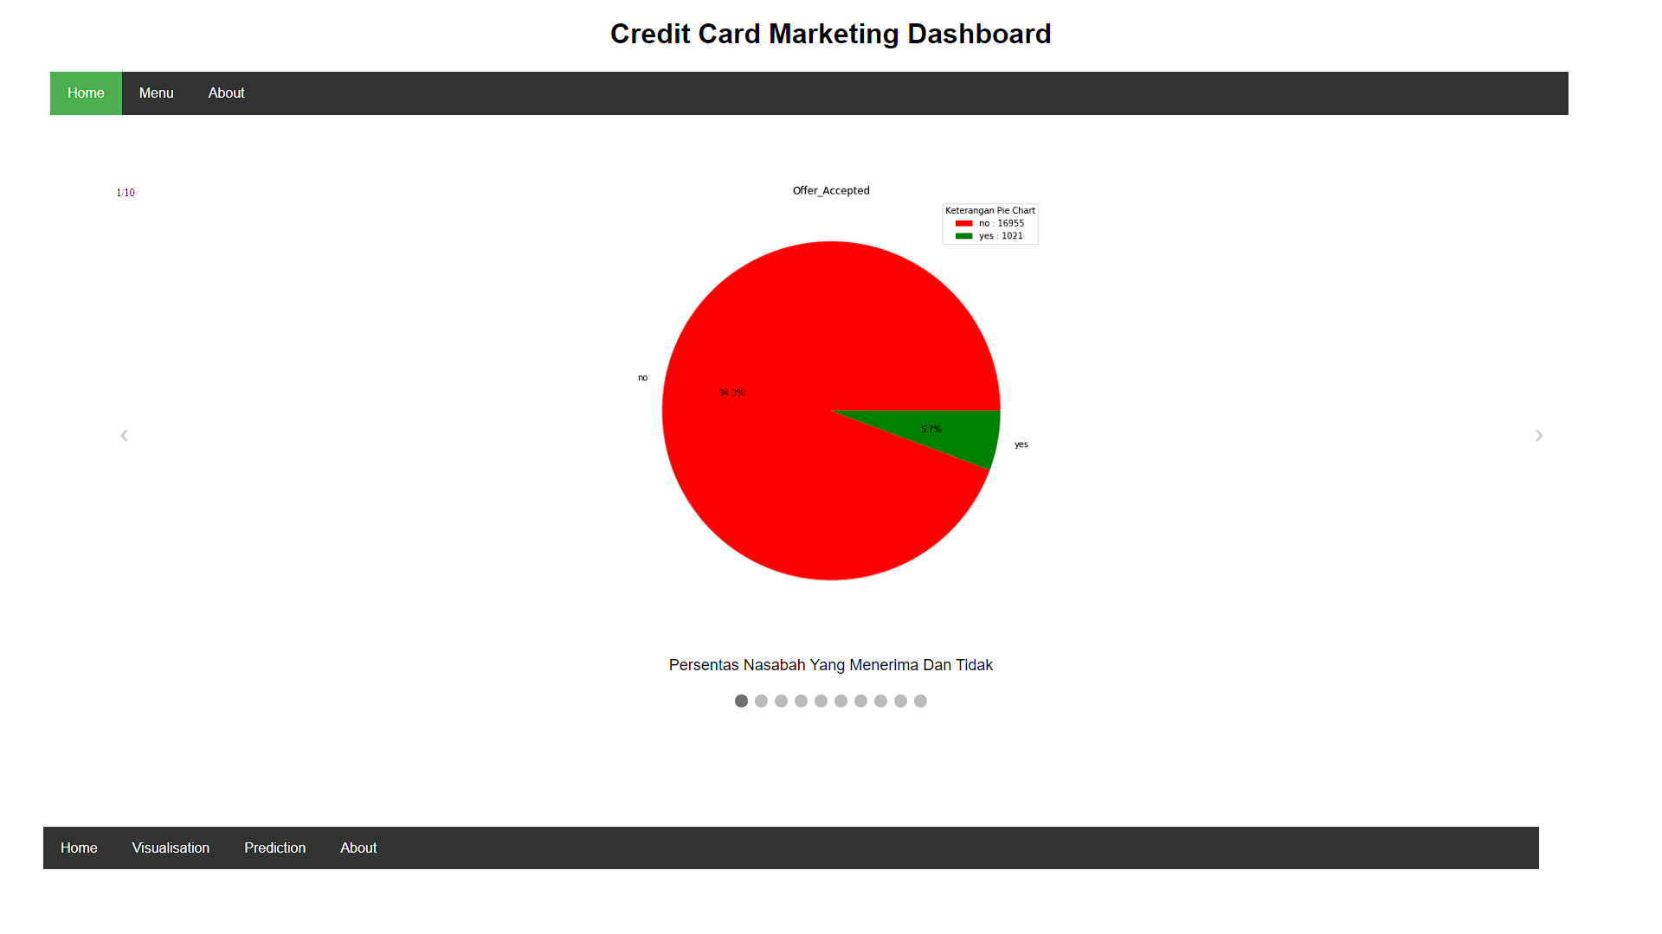
Application : Visualization

Slide 13
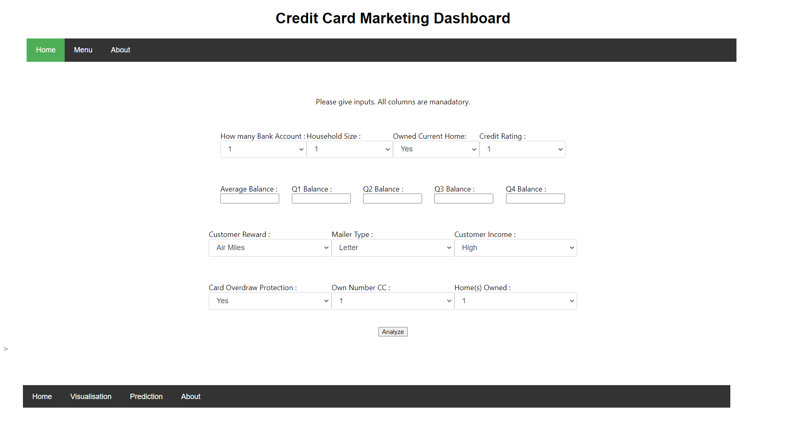
Application : Prediction Input

Slide 14
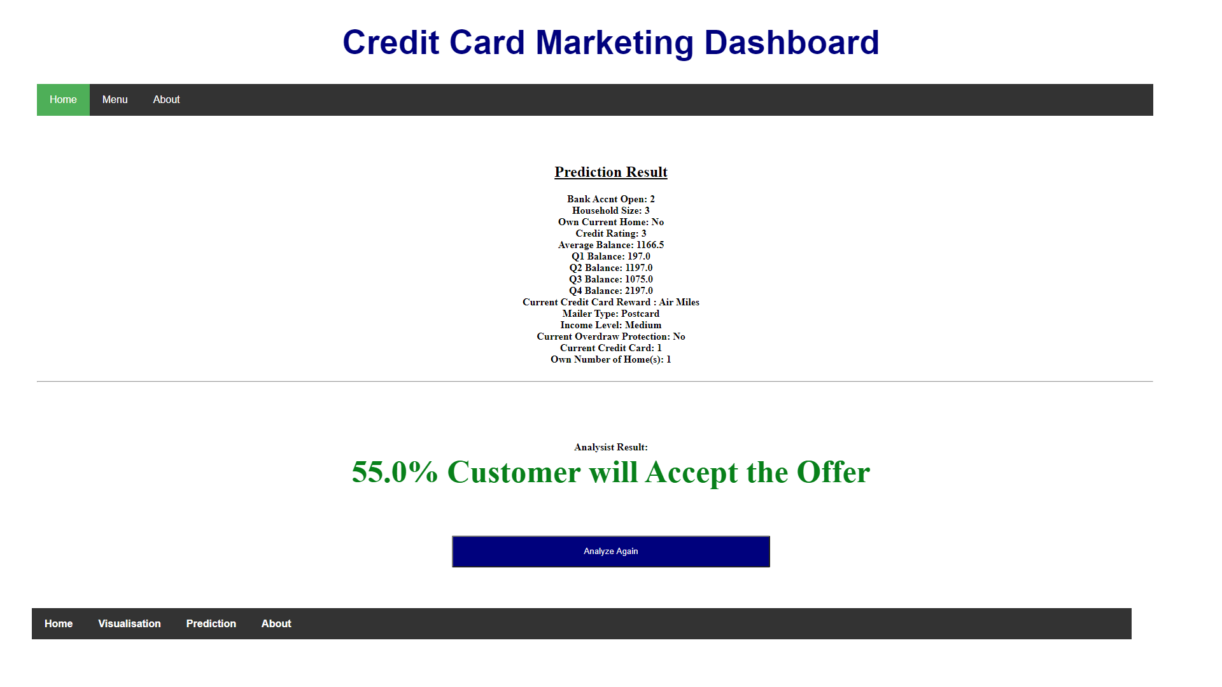
Application : Prediction Result

Slide 15
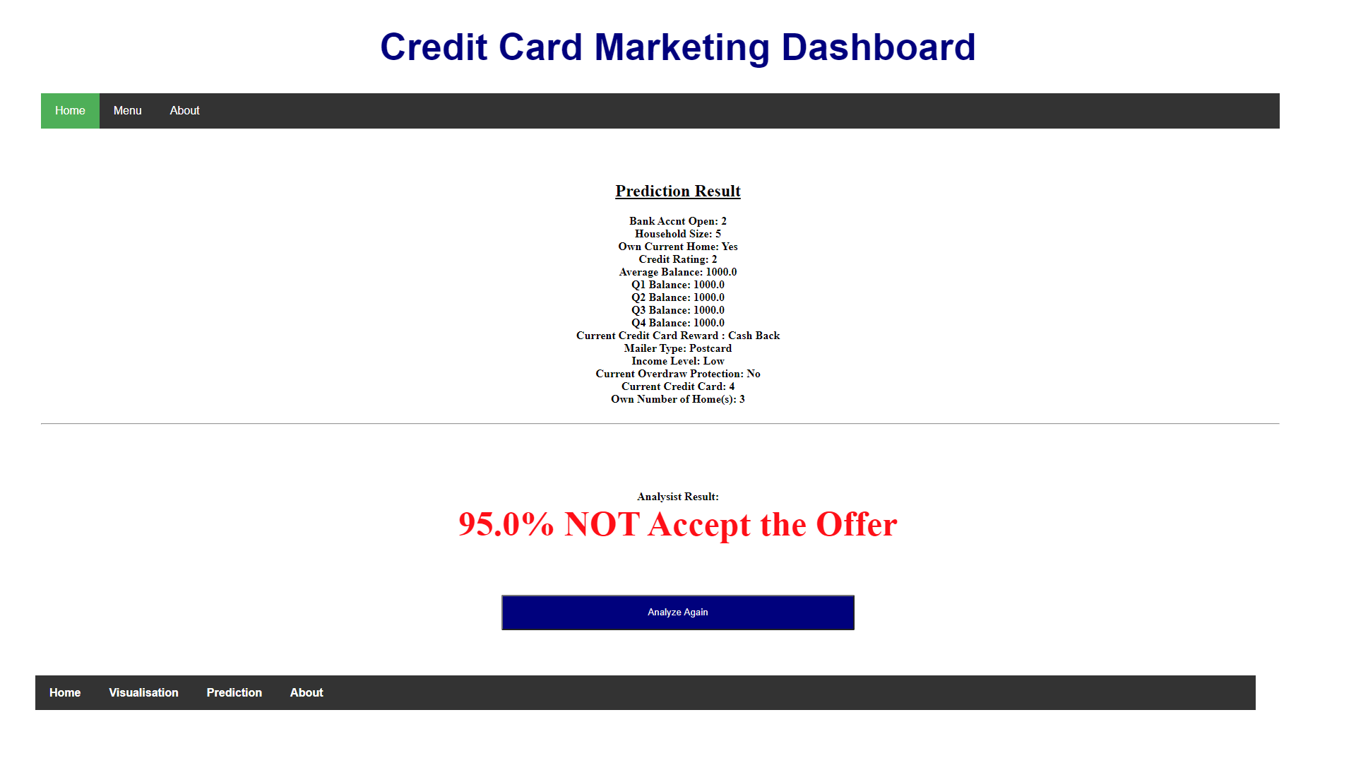
Application : Prediction Result

Slide 16
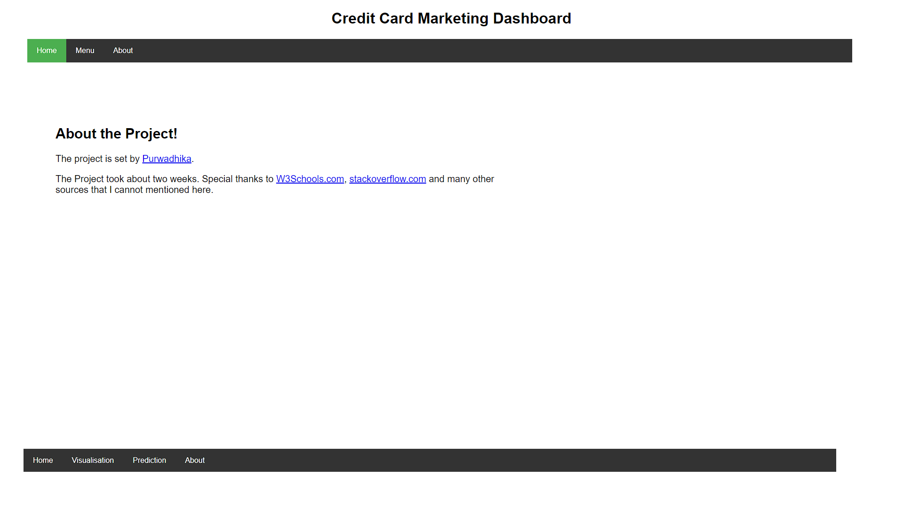
Application : About

Slide 17

THANK YOU!
Ryan Natanael Sihono
Phone
0812-1326-2399
Email
ryan.ind@outlook.com

